Slide 1
SI 206 Discussion 4:
The Terminal, Git, and Rectangles

Slide 2
The Terminal

Slide 3
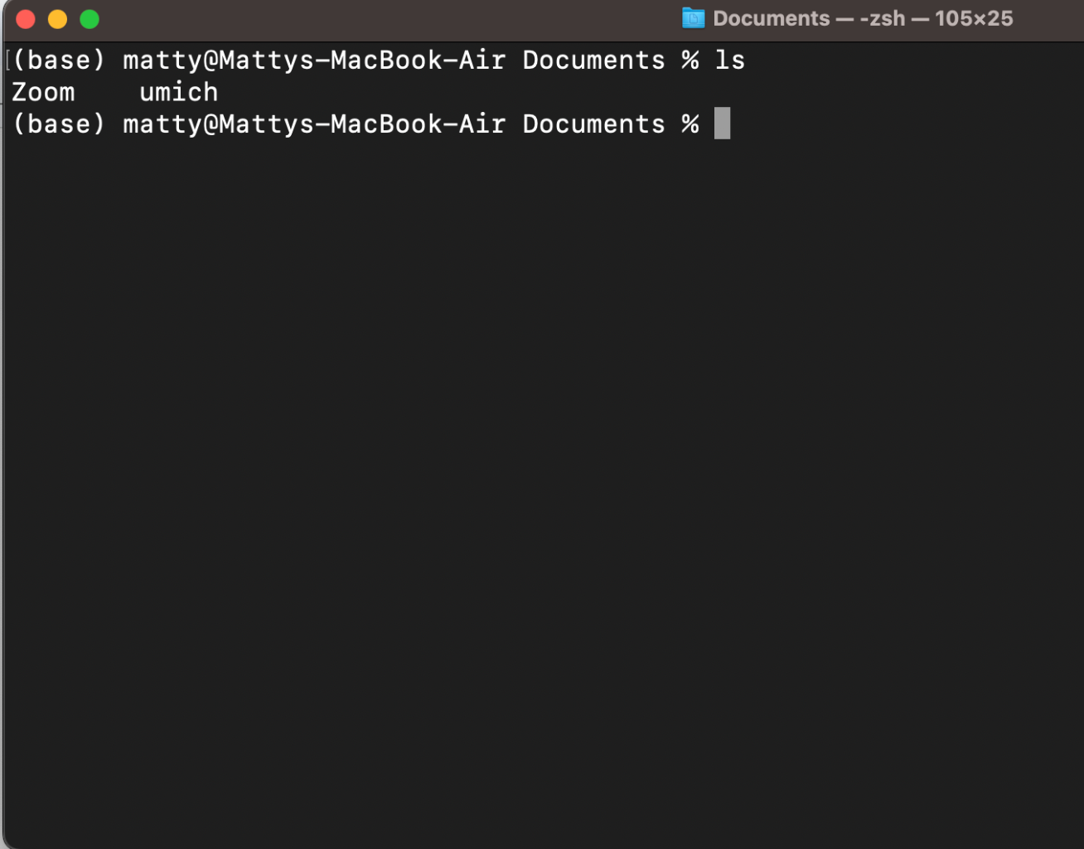
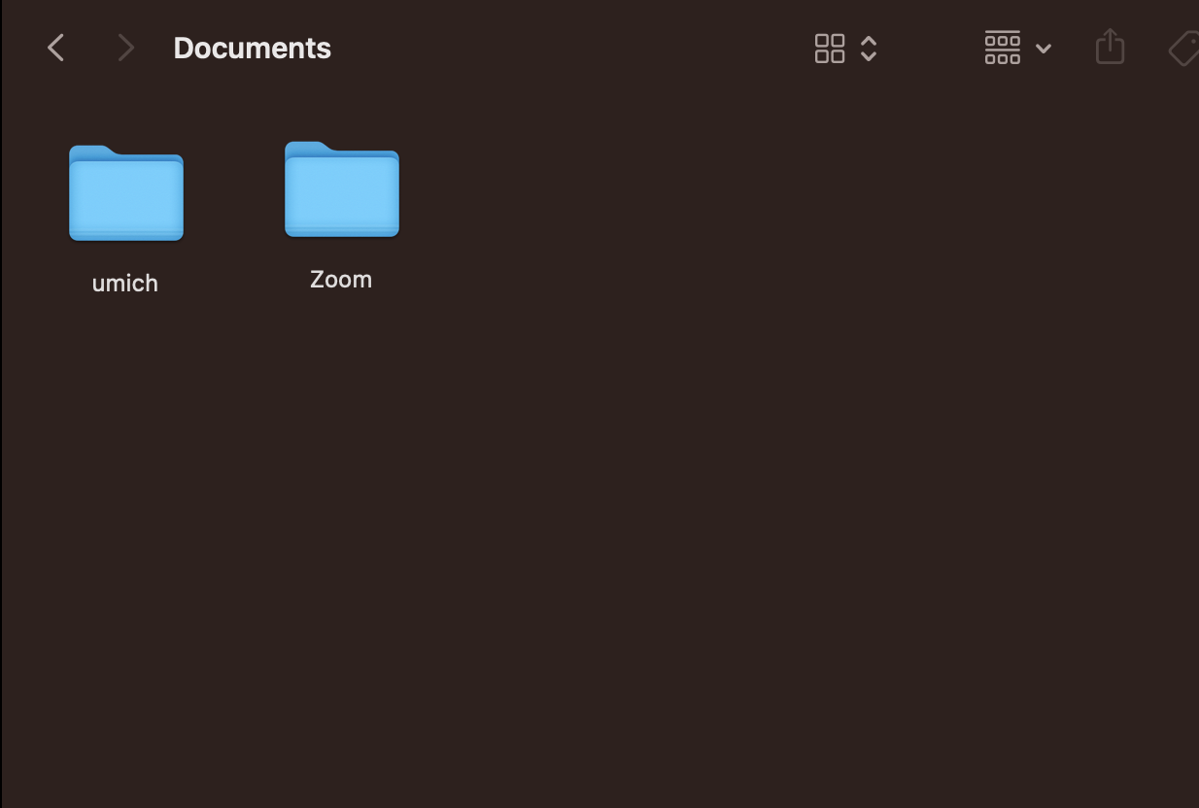
The Terminal
Command Line Interface (CLI)
Graphical User interface (GUI)

Slide 4
Basic Commands
GUI | CLI Command | Example
* current folder | pwd | pwd
* display folder contents | ls | ls
navigate/ change location | cd | cd SI206
make a new folder | mkdir | mkdir my_new_folder
N.B.
GUI = “folder”
CLI = “directory”

Slide 5
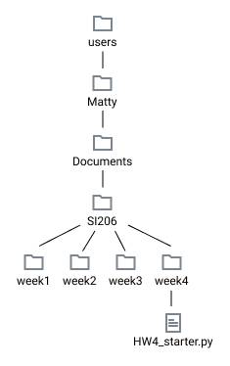
Paths
Special Characters:
current directory = .
parent directory = ..
home directory = ~
root directory = /
cd takes a path as an argument of which there are two kinds:
Relative path If you are in "SI206" cd week4
If you are in "Matty" cd Documents/SI206/week4
If you are in “week3”
cd ../week4
Absolute path Path from root directory cd /users/Matty/Documents/SI206/week4 Path from home directory cd ~/Documents/SI206/week4

Slide 6
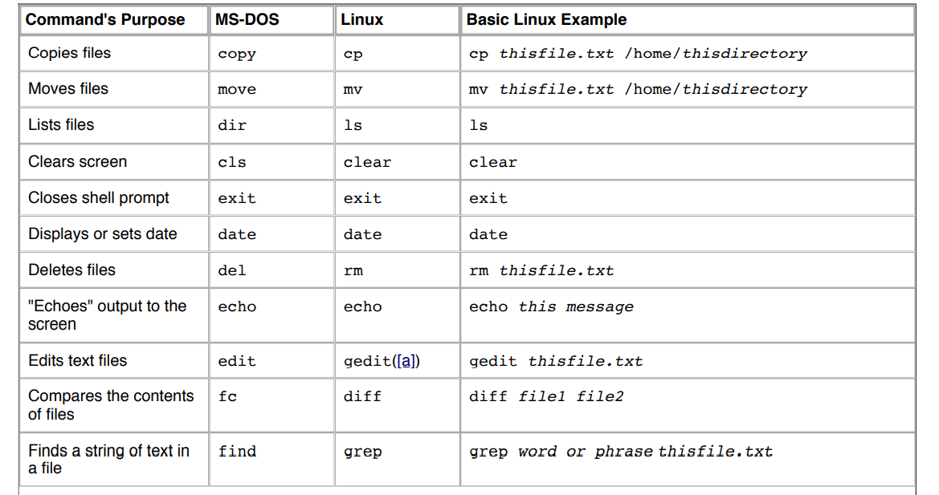

Slide 7
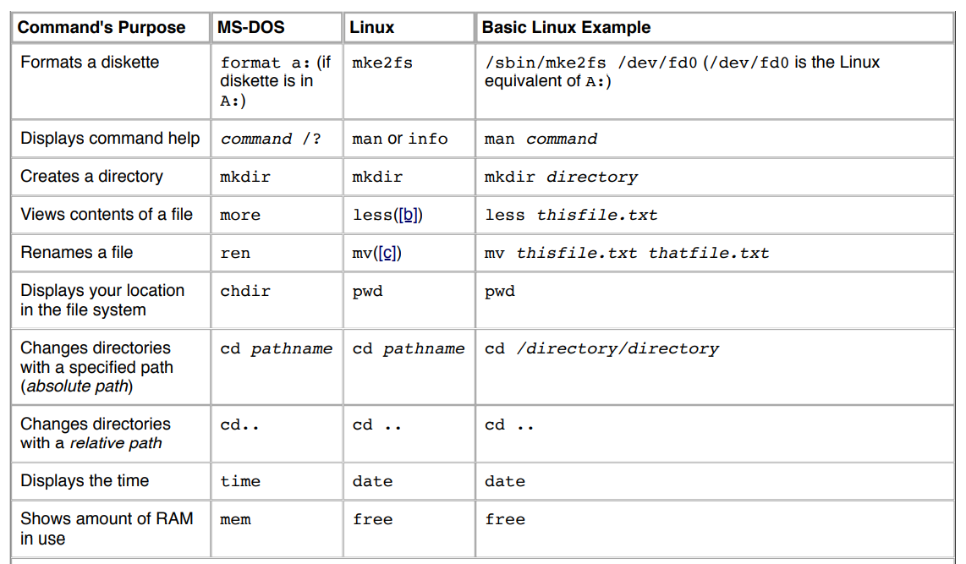

Slide 8
Git & Github

Slide 9
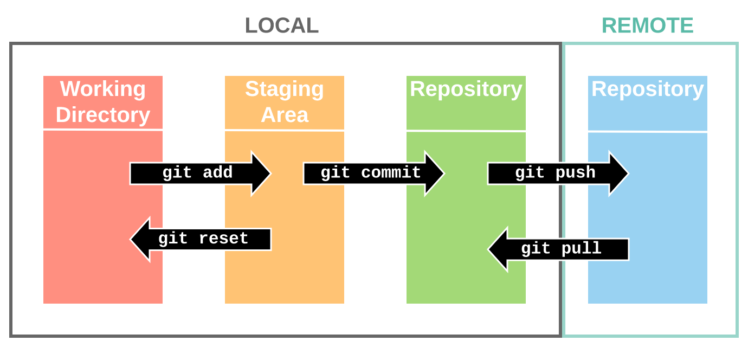

Slide 10
Typical Git Flow
git clone <link>
git add <file(s) you are modifying>
make your changes
git commit -m <message>
git push
use git status throughout to keep track

Slide 11
Time to Practice!

Slide 12
Practice
Object oriented programing
Create a rectangle class and methods to calculate the area and perimeter.
Create the rectangle instances, and call the methods
Git : Commit code after each method and push to GitHub in the end
Please commit at least 4 times while working on your project; you might commit each time you finish writing a new a function or method.

Slide 13
Discussion 4 Assignment
Accept the github classroom assignment and clone the repo
if you are having issues:
Files -> Discussions ->
Discussion 4 -> discussion4_starter.py

Slide 14
Rectangle class
Problem 1. Create the constructor "__init__" method
with arguments width (an integer), height (an integer)
It sets an instance variable, "width" to the passed argument, width
It sets an instance variable, "height" to the passed argument, height
Problem 2. Create the "__str__" method
It returns a string, "A rectangle with width ____ and height ____"

Slide 15
Rectangle class
Problem 3. Create the "verify_input" method
It returns a boolean
True if the width and height are positive numbers
False otherwise
Problem 4. Create the "area" method
It first verifies inputs and returns "Invalid input" if they are invalid.
Otherwise, it returns the area of the rectangle.
Problem 5. Create the "perimeter" method
It first verifies inputs and returns "Invalid input" if they are invalid.
Otherwise, it returns the perimeter of the rectangle.

Slide 16
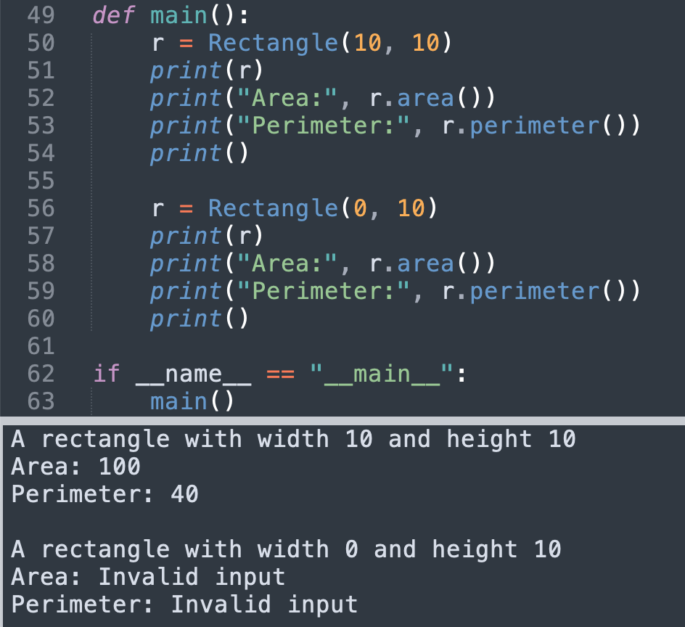
Sample output

